Slide 1
Weekly Presentation: Rotor Bearing System
Week number: 04
Date: 21/10/2025
Supervisor: Prof. Quell
Group members: Divyesh Mistry, Venkata Sreekanth .K , Sreehari Padachery, Jill Sadariya
Presenter : Jill Sadariya
Rotor Bearing System / Optimus Syria

Slide 2
Agenda
Task of the week.
Load equilibrium of 3-point suspension system.
Shaft calculation based on Shakti.
comparison between Journal bearing and Roller bearing.
Comparing the Reference bearings from previous Optimus.
Bibliography.
Jill Sadariya
Rotor Bearing System / Optimus Syria

Slide 3
Task of the week
Analyzed Force-Momentum diagram of current rotor bearing system.
Studied Rotor Shaft calculation and Solution from previous year projects.
Jill Sadariya

Slide 4
Loads equilibrium of 3-point suspension system
F_{ZR}​
F_{ZA}​
F_{S}s
F_{ZB}​
F_{G} s
F_{YR}​
F_{YA}​
F_{YB}​
M_{ZR}​
M_{YR}​
Rotor
F_{XR}​
F_{XB}​
Shaft C.G
Gear Box
M_{XR}​
Bearing A
Bearing B
L₁
L₂
L_{S}
L_{G}
Jill Sadariya

Slide 5
Loads equilibrium of 3-point suspension system
Calculation of Bearing Reaction Forces
F_{S} :Shaft gravitational force.
F_{G} : Gearbox gravitational force.
F_{A} : Radial Forces in (Y, Z) direction for Bearing A
F_{XR}​ : Force in X-direction at the hub
F_{YR} : Force in Y-direction at the hub
F_{ZR} : Force in Z-direction at the hub
M_{XR} : Moment in X-direction at hub
M_{YR} : Moment in Y-direction at hub
M_{ZR} : Moment in Z-direction at hub
Equilibrium of Forces at Bearing (B):
∑𝑭_{𝑿}(𝑩)= 𝐹_{𝑋𝑅}+𝐹_{𝐵𝑋} =0
𝑭𝑩_{𝑿} = −𝐹_{𝑋𝑅}
∑𝑭_{𝒀}(𝐵) = 𝐹_{𝑌𝑅}+𝐹_{𝐴𝑌}+𝐹_{𝐵𝑌} =0
𝑭_{𝑩𝒀}= −𝐹_{𝑌𝑅}−𝐹_{𝐴𝑌}
∑𝑭_{𝒁}(𝑩)=𝐹_{𝑍𝑅}+𝐹_{𝐴𝑍}+𝐹_{𝐵𝑍}−𝐹_{𝑠}−𝐹_{𝑔}=0
𝑭_{𝑩𝒁}= −𝐹_{𝑍𝑅}−𝐹_{𝐴𝑍}+𝐹_{𝑠}+𝐹_{𝑔}
Jill Sadariya

Slide 6
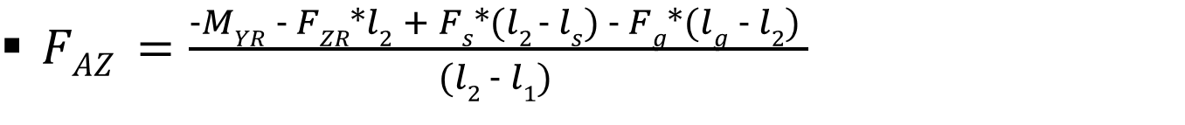

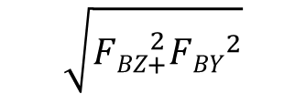
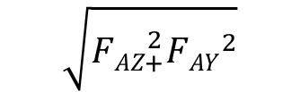

Equilibrium of Moments at Bearing (B):
∑𝐌_{𝐙}(𝑩)=M_{ZR}−𝐹_{𝑌𝑅}∗l₂−𝐹_{𝐴𝑌}∗(l₂−l₁)=0
$\text{F}\text{AY} \text{=}\frac{\text{M}\text{ZR}\text{−}\text{FYR}\text{∗}\text{l}\text{2}}{\text{(}\text{l}\text{2}\text{−}\text{l}\text{1}\text{)}}$
∑𝐌_{𝐘}(𝑩)=M_{YR}+𝐹_{𝑍𝑅}∗l2+𝐹_{𝐴𝑍}∗(l₂−l₁)−𝐹_{𝑠}*(l₂−l_{S})+𝐹_{𝑔}∗(l_{g}−l₂)=0
$FAZ =\frac{−MYR − FZR∗l2 + Fs∗(l2 − ls) − Fg∗(lg − l2) }{(l2 − l1) }$
$$\sqrt{{FAZ}_{+}^{2}{FAY}^{2}}$$
$$\sqrt{{FBZ}_{+}^{2}{FBY}^{2}}$$
F_{Aresult}=
F_{Bresult}=
Jill Sadariya

Slide 7
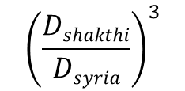
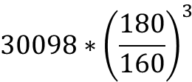
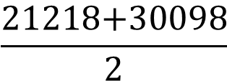

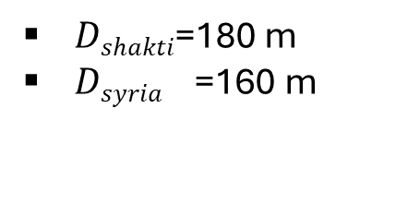
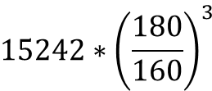
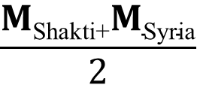
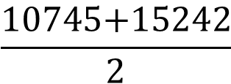
Shaft calculation based on Shakti
Parameter | Description | Value | unit | Source
M_{res} (= M_{b}) | Bending Moment | 30098 | KNm | Shakti
M_{t} | Torsional Moment | 15242 | KNm
$\frac{\text{M}\text{Shakti}}{\text{M}\text{Syri}a IIIA}$ ₌
$${\left(\frac{Dshakthi}{Dsyria}\right)}^{3}$$
$Dshakti$=180 m
$Dsyria$ =160 m
$$\frac{\text{M}\text{Shakti}\text{+}\text{M}\text{Syria}}{2}$$
𝐌_{Syria,II A} =
$\text{M}\text{Bending}\text{Shakti} \text{= 30098 }\text{KNm}$
$${30098∗\left(\frac{180}{160}\right)}^{3}$$
$$\frac{\text{21218+30098}}{2}$$
= 21218 kNm
𝐌_{Syria,II A} $\text{Bending}$ =
𝐌_{Syria,III A} $\text{Bending}$ =
= 25658 kNm
$${15242∗\left(\frac{180}{160}\right)}^{3}$$
𝐌_{Syria,III A}$\text{Torsional}$ =
= 10745 kNm
𝐌_{Syria,II A}$\text{Torsional}$ =
$$\frac{\text{10745+}15242}{2}$$
= 12993 kNm
Jill Sadariya

Slide 8
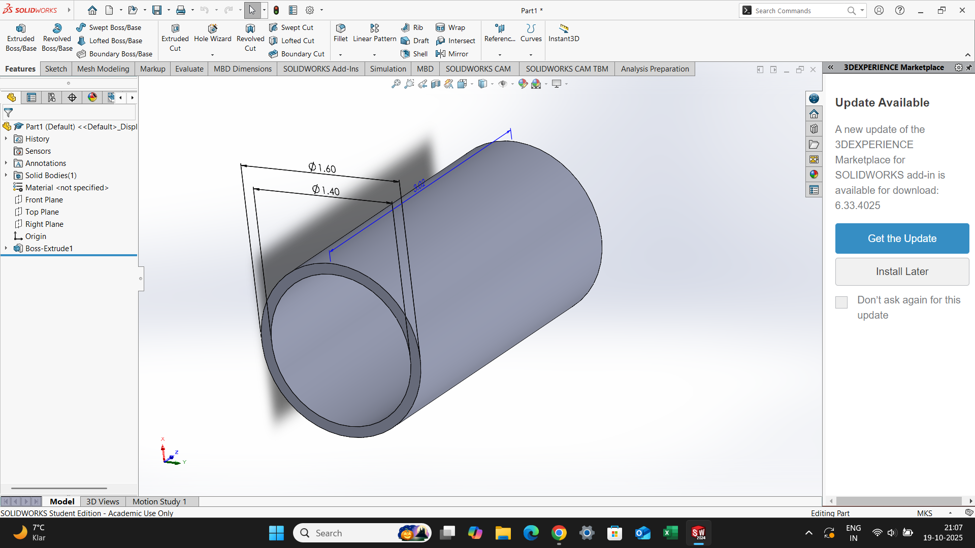
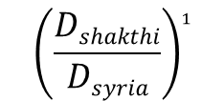
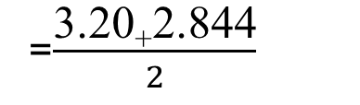
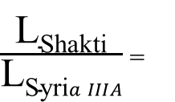
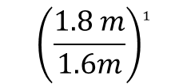
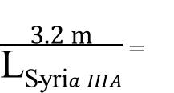
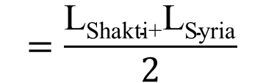
Shaft calculation based on Shakti
$\frac{\text{L}\text{Shakti}}{\text{L}\text{Syri}a IIIA}$ ₌
$${\left(\frac{Dshakthi}{Dsyria}\right)}^{1}$$
OD
ID
$\frac{\text{3.2 }\text{m}}{\text{L}\text{Syri}a IIIA}$ ₌
$${\left(\frac{1.8 m}{1.6m}\right)}^{1}$$
L_{Syria,III A} = 2.844m
$$=\frac{\text{L}\text{Shakti}\text{+}\text{L}\text{Syria}}{2}$$
L_{Syria,II A}
=$\frac{\text{3.20}\text{+}\text{2.844}}{2}$
L_{Syria,II A} = 3.02 m
Thickness: .20 m
Jill Sadariya

Slide 9
comparison between Journal bearing and Roller bearing
Feature | Hydrodynamic Journal Bearing | Spherical Roller Bearing
Primary Strength | Extreme durability and potential for up-tower repair. | Proven technology with excellent misalignment handling.
Primary Weakness | System complexity and reliance on auxiliary systems. | High premature failure rate and catastrophic replacement cost.
Load Handling | Excellent | Excellent
Low-Speed Operation | Poor (Requires mandatory hydrostatic lift system) | Excellent
Misalignment Tolerance | Excellent (with spherical-pivot tilting pads) | Excellent (inherent to design)
Projected Lifespan | 25+ years (theoretically infinite with proper maintenance) | Often fails in <10 years
Maintenance | Monitoring of oil system; potential for up-tower pad replacement. | Grease replenishment; failure requires full drivetrain removal.
System Complexity | High (bearing, pump, filters, controls, robust sealing) | Moderate (bearing, housing, seals, grease lines)
Jill Sadariya

Slide 10
Comparing the Reference bearings from previous Optimus
SKF bearing reference | 24088 ECA/W33 | 240/710 ECA/W33
Bore diameter | 440 mm | 710 mm
Outer diameter | 650 mm | 1030 mm
Width | 212 mm | 315 mm
Dynamic load rating (approx.) | ~2,800 kN | ~5,500 kN
Applications | Medium-to-large rotating equipment | Very large, heavy-duty (e.g., turbines, large gearboxes)
 | Optimus 60 E | Optimus 92 L E
Jill Sadariya

Slide 11
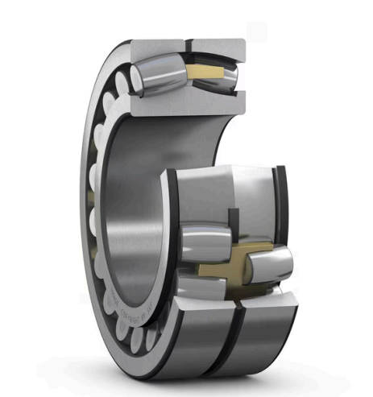
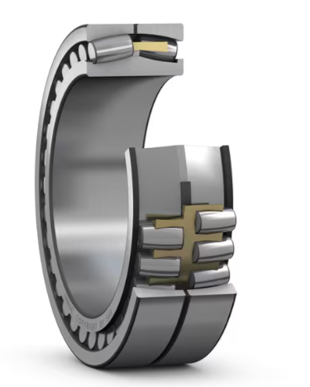
SKF -Spherical roller bearing
24088 ECA/W33
240/710 ECA/W33
Spherical roller bearing with relubrication features
Source :SKF
Jill Sadariya

Slide 12
Bibiliography
SKF. (n.d.). Spherical roller bearing 240/710 ECA/W33. SKF. Retrieved October 18, 2025, from https://www.skf.com/ch/de/products/rolling-bearings/roller-bearings/spherical-roller-bearings/productid-240%2F710%20ECA%2FW33
Divyesh Mistry

